Slide 1

Welcome To The Java Project Presentation​

Slide 2


Project Title Expense & Inventory Management System

Slide 3

Team Members
Soumitra Saha (356)
Mesbah Uddin Aqib (346)
Sukonya Dutta Pushpa (362)
Nur Mohammad (333)

Slide 4

What is Expense & Inventory Management System
An Inventory and Expense Management System is software that helps businesses efficiently manage their stock of products as well as track and control their expenses. It keeps records of:
Inventory levels, incoming shipments, and outgoing sales to ensure optimal stock and avoid shortages or excess.
Daily expenses, categorized spending, and budget monitoring to control costs and improve financial planning.
This combined system helps businesses streamline operations, reduce costs, and maintain better control over both their inventory and financial resources.

Slide 5
Financial control and transparency
Accurate inventory tracking
Improved decision making
Time and cost efficiency
Prevents fraud and theft
Better cash flow management
Compliance and reporting
Scalability for business growth
Why we need this management system

Slide 6
Key Features Of Our Project :
User Authentication and Role-Based Access
Transaction Management
Inventory Management
Category Management
Reporting
System Settings

Slide 7
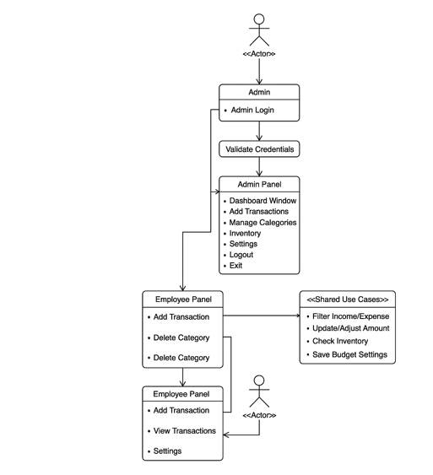

Project Overview

Slide 8
Libraries & APIs
AWT
JDBC
Java Time
Swing
Java Math

Slide 9
Core Techniques
Event-Driven Programming
Layout Management
Custom Painting
Table Models
Input Validation & Error Handling

Slide 10
Benefits Of Our Projects
Role-based navigation allows admins and employees to log in separately.
GUI provides a friendly interface for non-technical users.
Clean UI is helpful for non-IT staff.
Easy-to-use desktop application, no need for web hosting or advanced IT support.
Useful for daily tracking of purchases, utilities, payroll, and inventory spending.
Budget-friendly as it's a Java desktop application (no licensing costs)

Slide 11
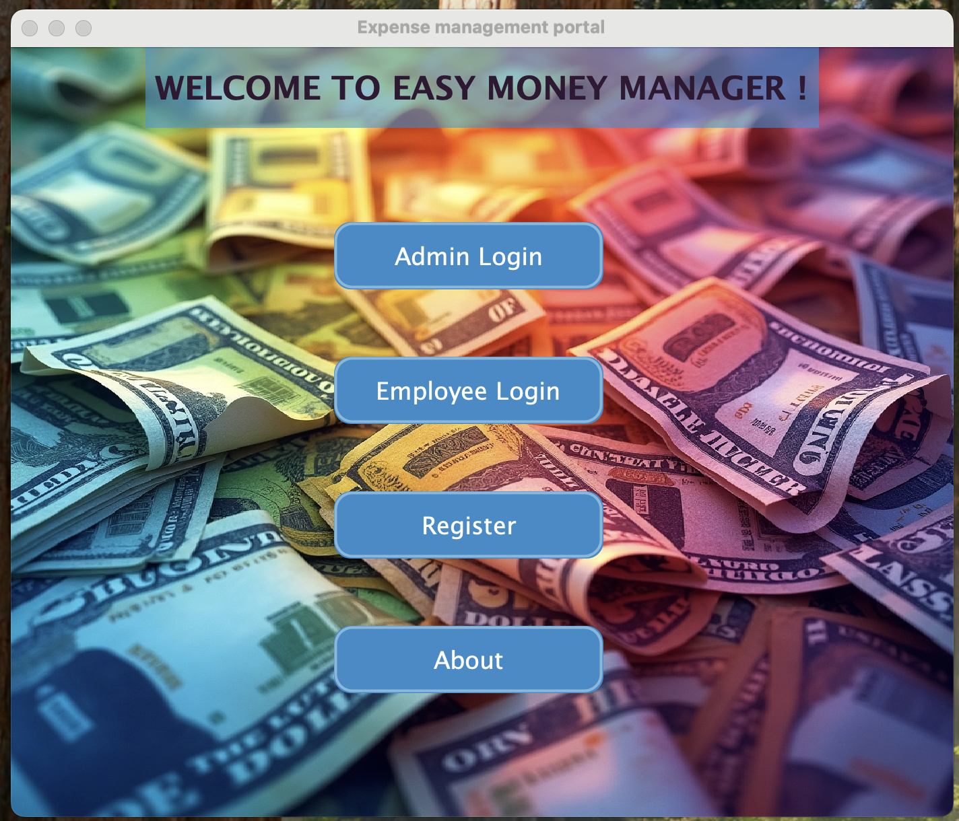

Slide 12
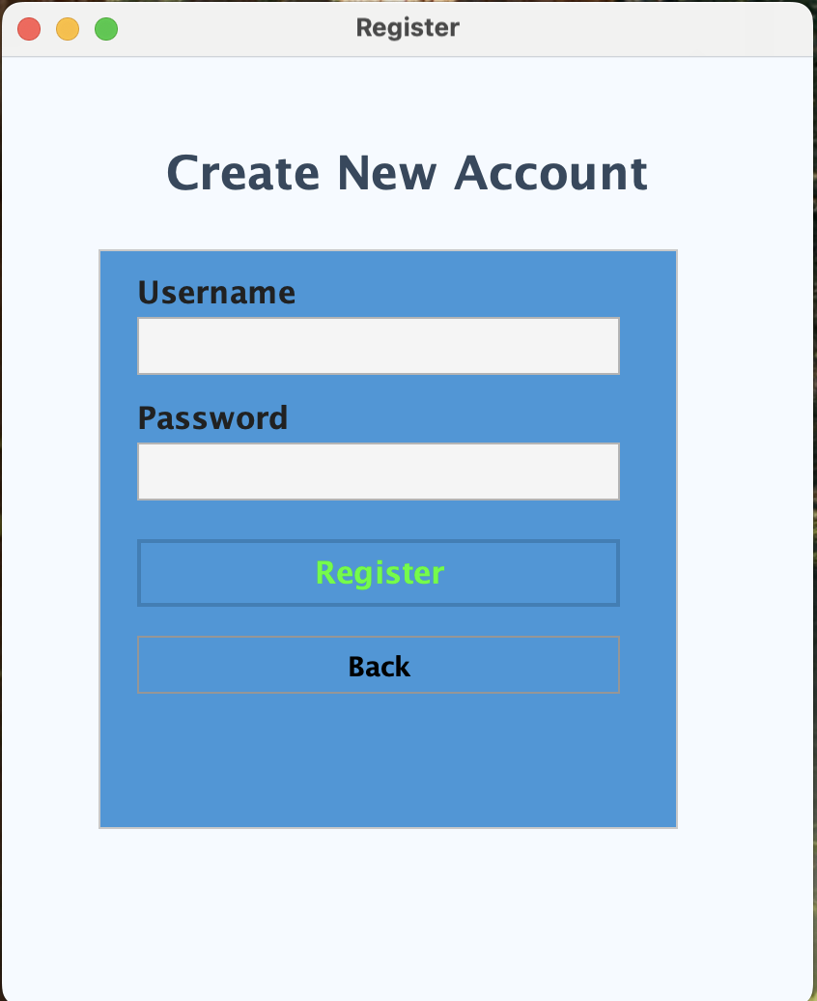

Slide 13
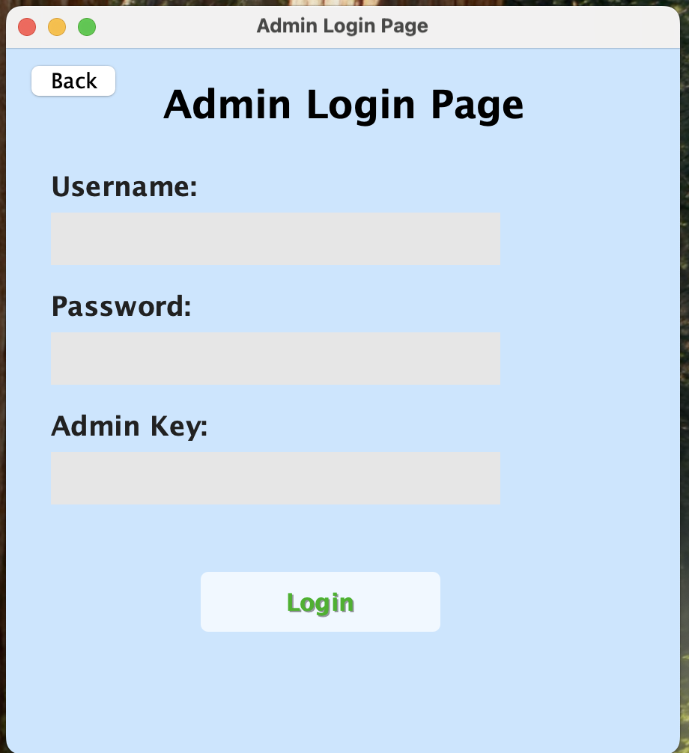
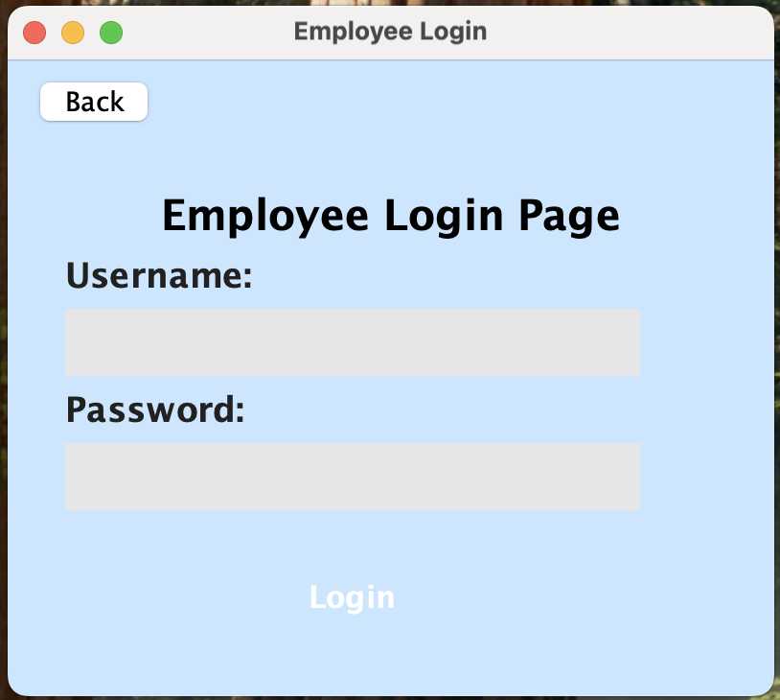

Slide 14
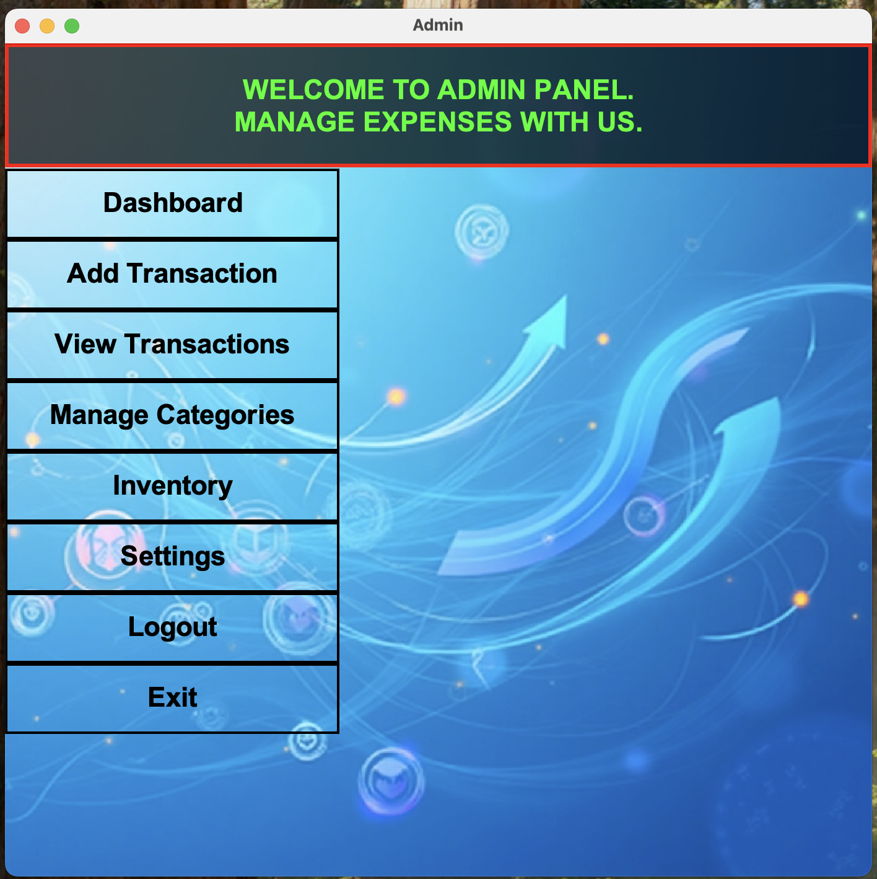
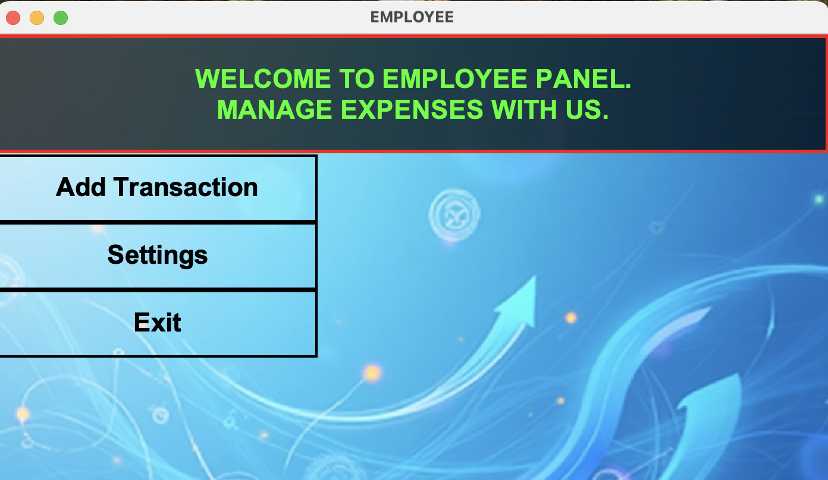

Slide 15
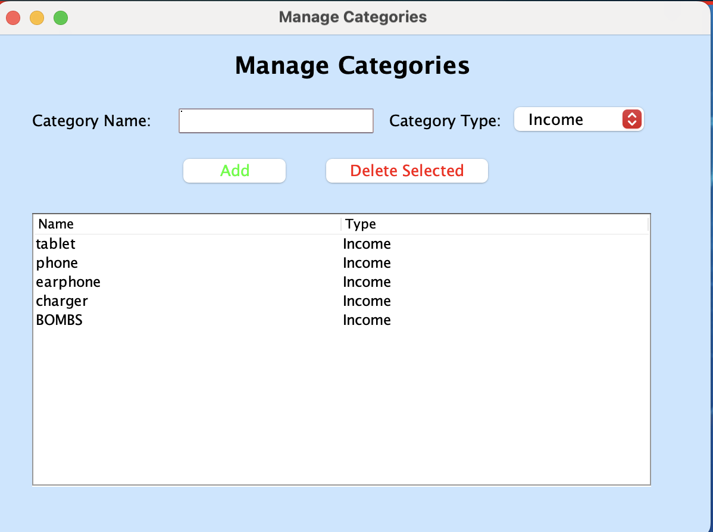
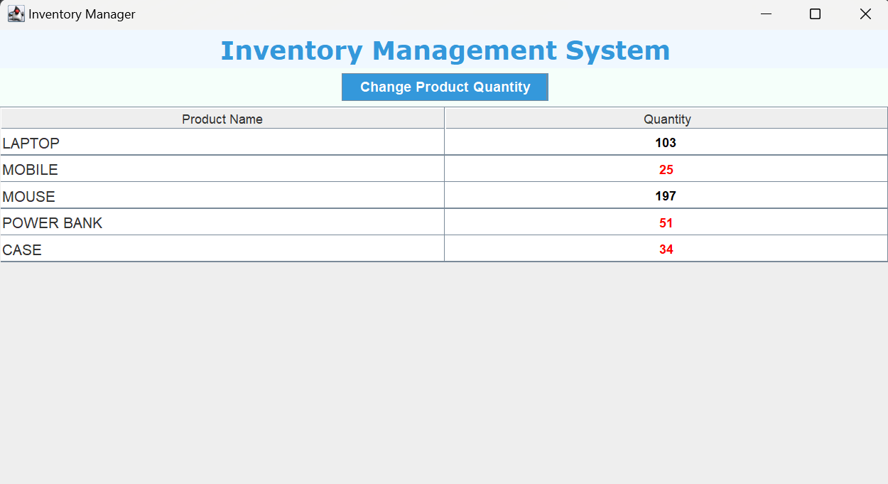

Slide 16
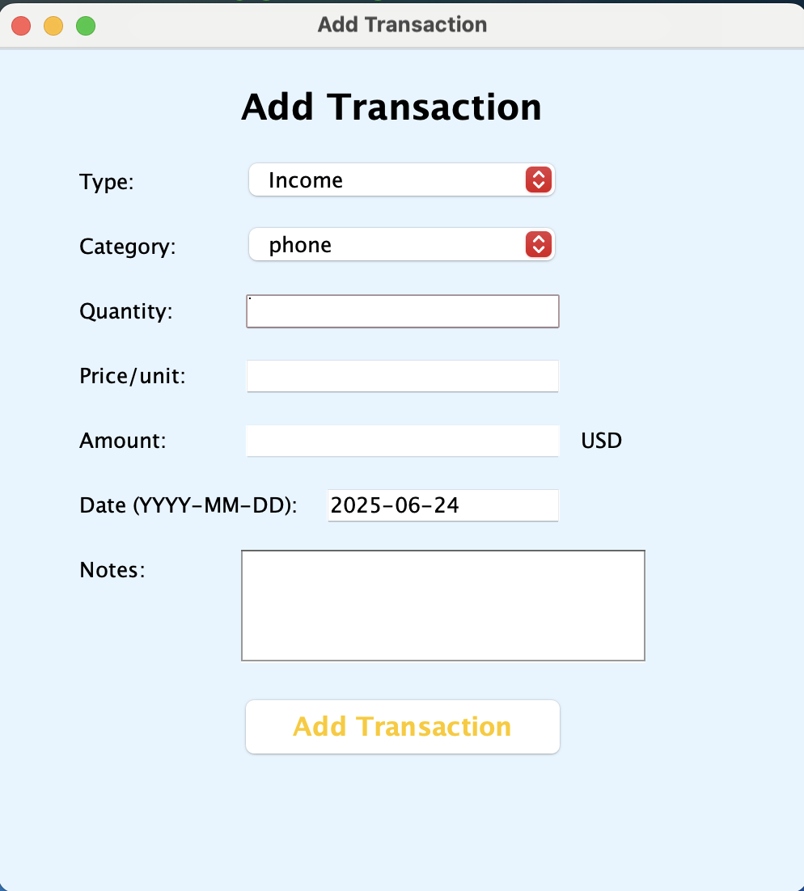
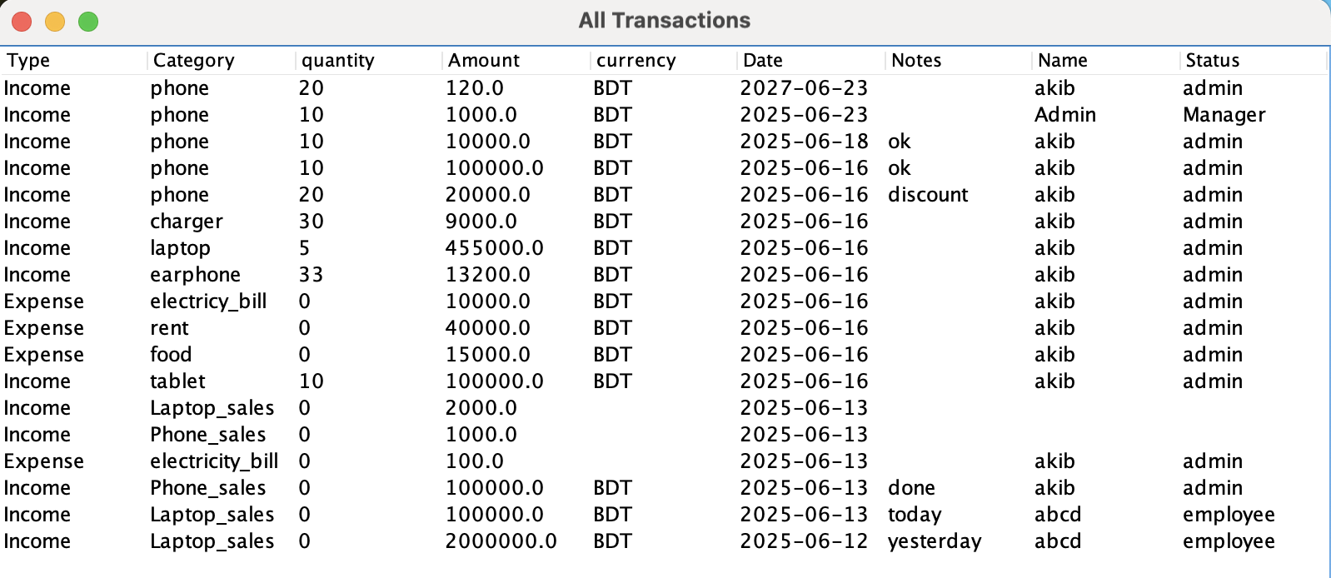

Slide 17
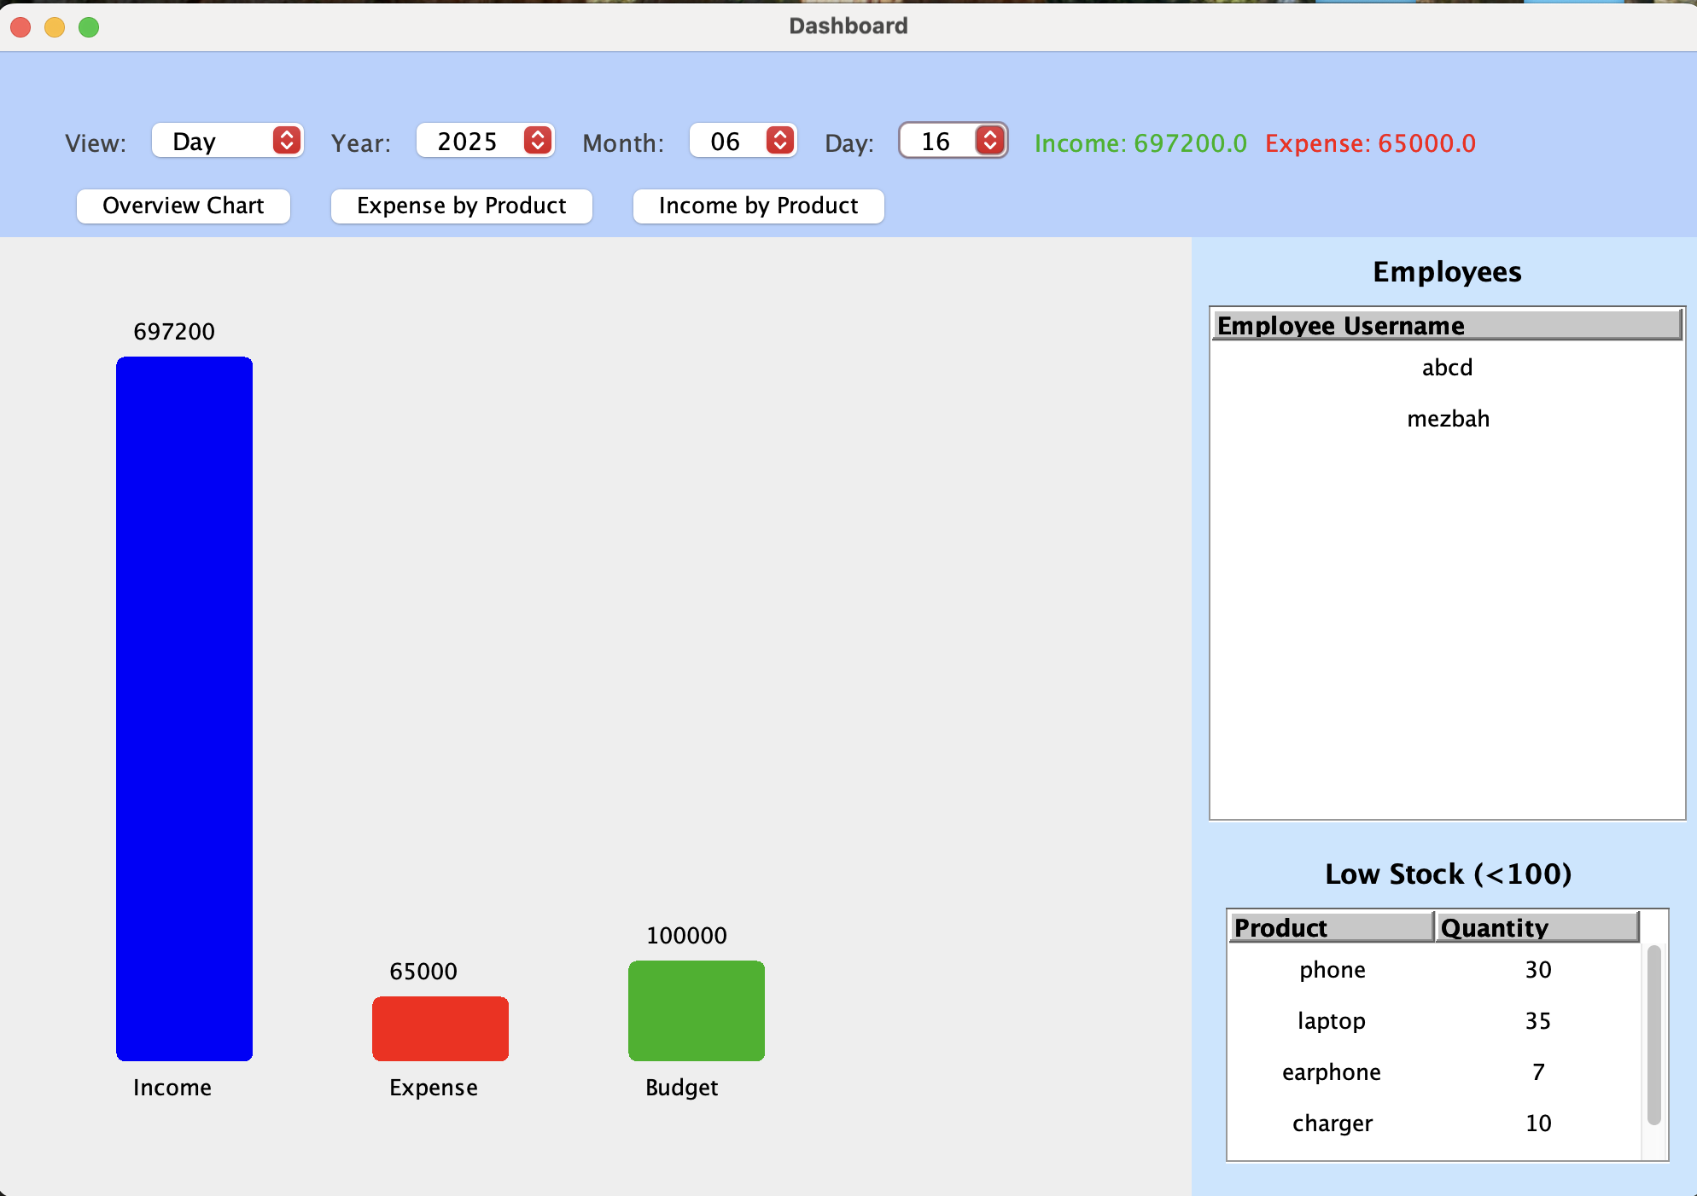
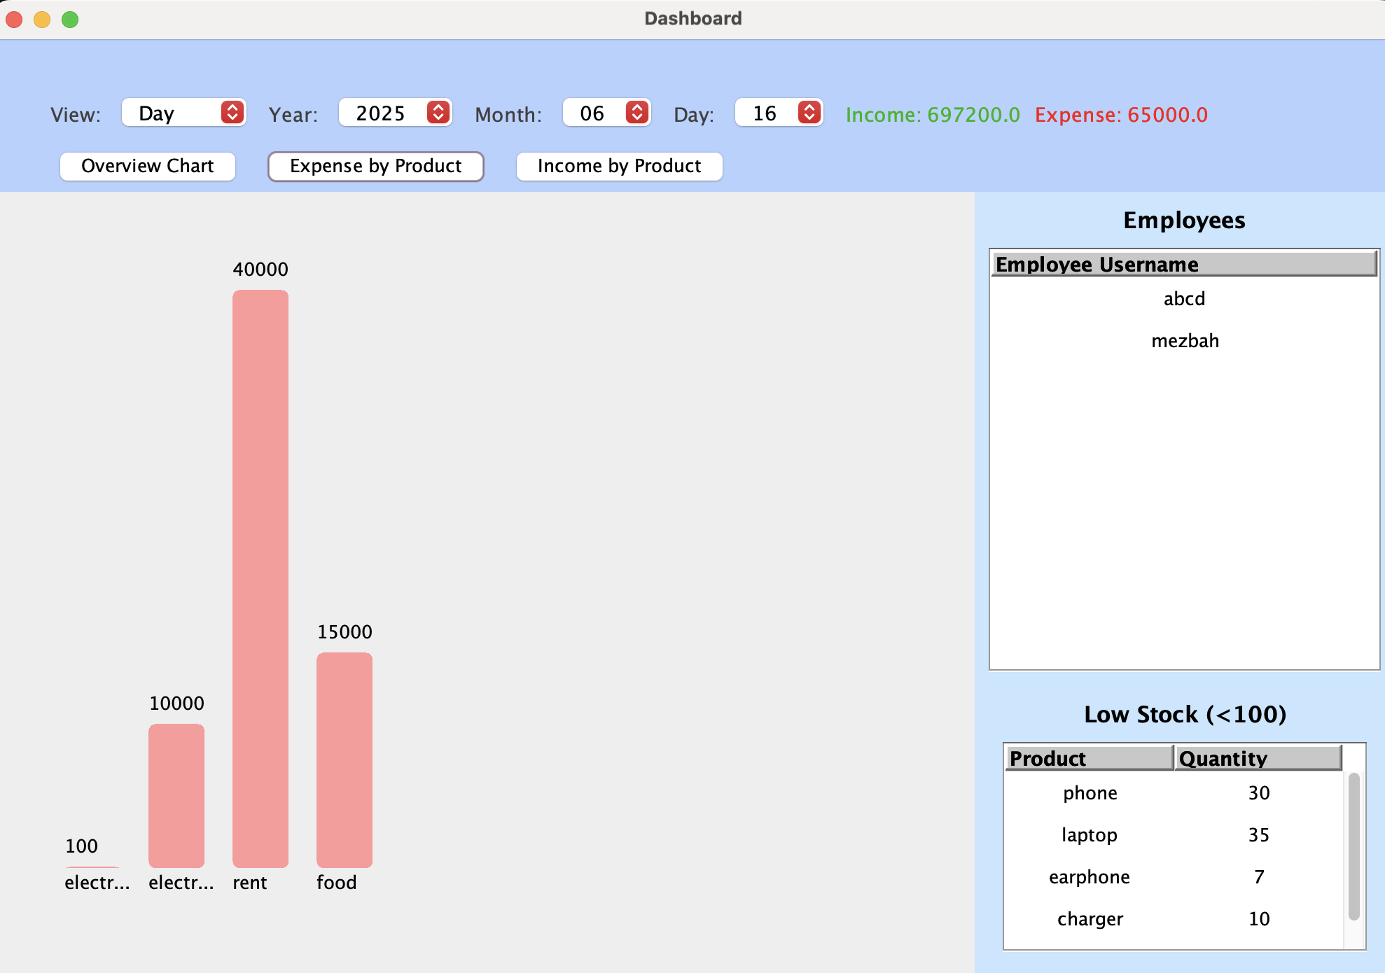
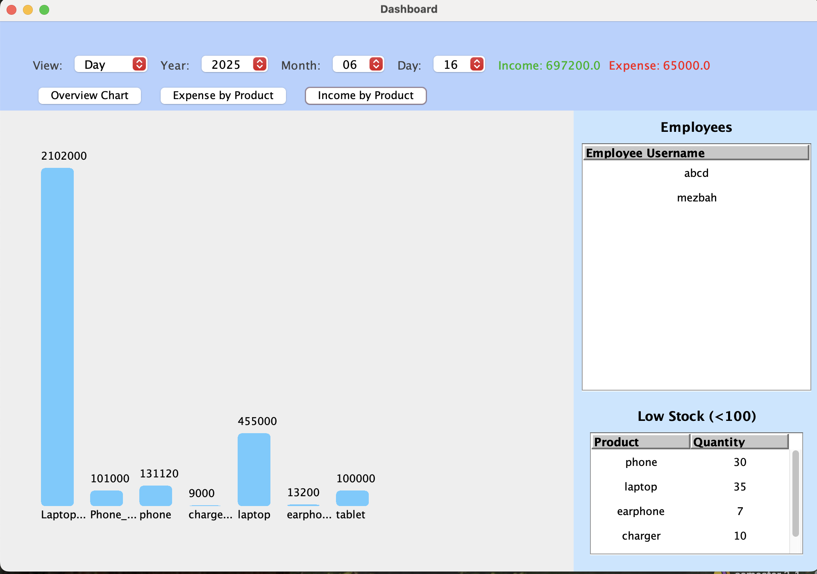

Slide 18
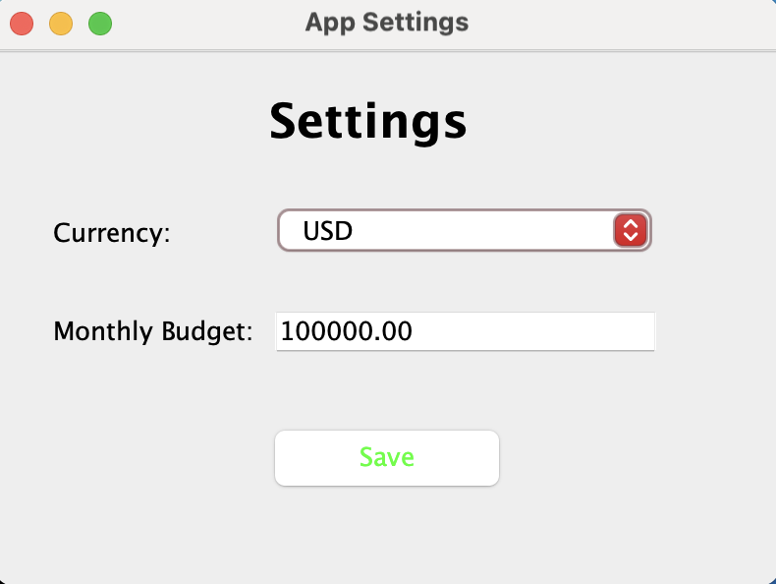

Slide 19
Scope for improvements
Lack of Cloud or Multi-user Access : The system is designed for single-user use on one device, making it unsuitable for teams needing simultaneous access or remote collaboration. In solution we can develop develop a cloud-based version that supports multiple users accessing and updating data concurrently.
Limited Security Features :Weak or missing security measures expose sensitive financial and login data to risks.Use encrypted storage for passwords and sensitive data, applying hashing and salting techniques.Implement secure authentication methods (e.g., OAuth, two-factor authentication).

Slide 20
Github & LinkedIn Profile Link
Nur Mohammad : https://github.com/NurMohammad-333/Java-Easy-Money-Manager

Slide 21
Thank You

